Slide 1
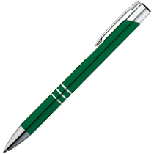
Pen

Slide 2
Pencil

Slide 3
Rubber

Slide 4
Ruler

Slide 5
Pencil Case

Slide 6
Sharpener

Slide 7
Crayon

Slide 8
Notebook

